Slide 1

MonetizePros.com
Digital Media Kit
March 2014

Slide 2
Site Overview
is an online community designed to help website owners and online entrepreneurs make more money from their existing traffic.
Our audience, which consists primarily of online entrepreneurs and web publishers, tends to be:
Sophisticated
Web-Savvy
Primary Decision Makers

Slide 3
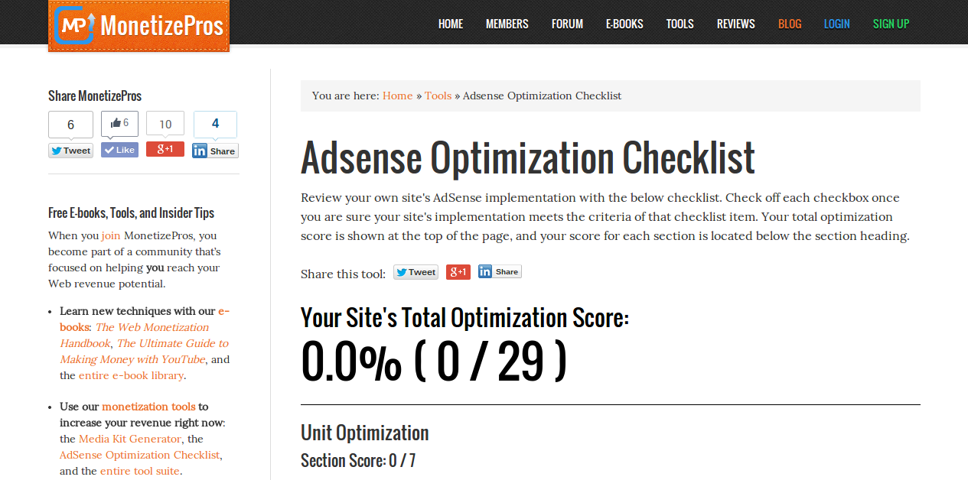
Site Content
MonetizePros.com Features:
Member Forums
Monetization Blog
E-Books
Monetization Tools
Network Reviews
Tutorials

Slide 4





About Our Audience
1,000+
2,000+
257%
E-Newsletter Subs
Registered Members
1 Year Traffic Growth
2:29
25%
Avg. Time on Site
Returning Visitors
Source: Google Analytics

Slide 5





About Our Audience
Bachelor: 62%
Male: 55%
Masters: 19%
Gender
Female: 45%
Education
No Degree: 19%
18-34: 38%
$100K+: 55%
35-54: 28%
$50 - $100K+: 25%
Age
55+: 20%
Household Income
<$50K: 20%
<18: 14%
Source: Quantcast

Slide 6
Advertising Opportunities
Ad Unit | Dimensions | Formats | Cost (CPM)
Leaderboard | 728x90 | SWF, JPG | $25
Small Rectangle | 160x600 | SWF, JPG | $20
Large Rectangle | 300x600 | SWF, JPG | $30
For more information or details on other custom advertising opportunities, contact us at info@monetizepros.com

